Slide 1
Electrical and Controls Workshop – The Basics
Mike McIntyre & Rahamath Shaik
September 26, 2015
(with props to Tom Barch!)

Slide 2
The Agenda
Electrical Terminology
The Battery
Overcurrent Protection
Power Distribution
Control System Overview
  How the system works
  Cortex Controller
  VEXnet Joysticks
Wireless Devices
Motor Control
Pneumatic Control

Slide 3
Electrical Terminology
Charge
Current
Resistance
Emf (voltage)
Power
Circuit
Short circuit

Slide 4
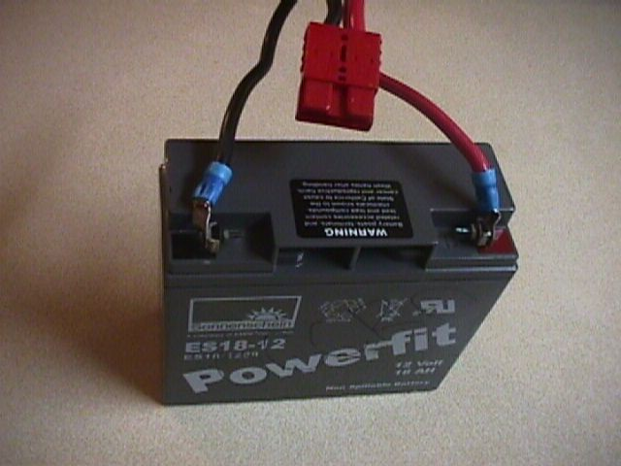
The Battery
Constant Voltage Source
Chemical Nature
Handling
Connectors
Charging
Maintenance
Testing

Slide 5
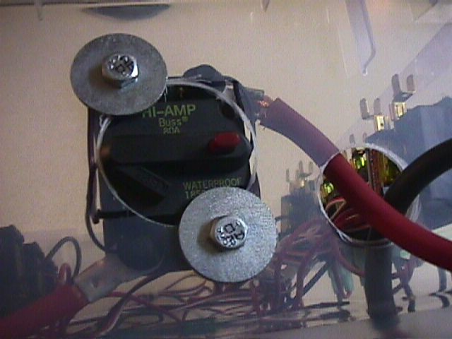
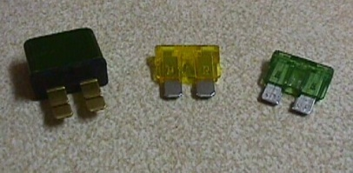
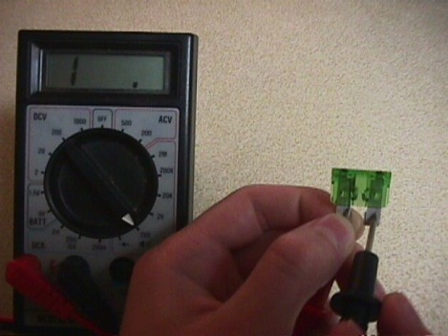
Overcurrent Protection
80-Amp Breaker and
the NEW 120-Amp!!!)
Slow-blow Circuit Breakers
Fuses

Slide 6
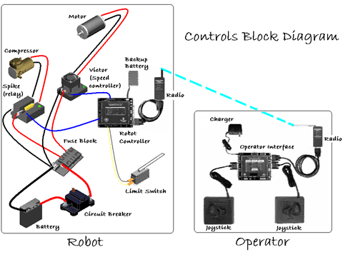
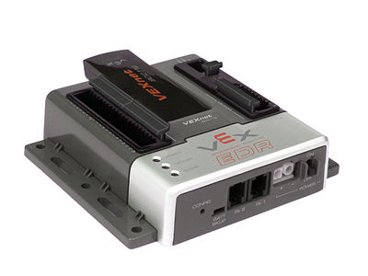
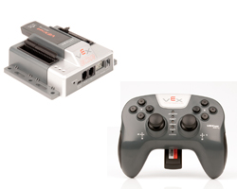

Master VEXnet Joystick

Slide 7
Radio vs. Tether communication
If the controllers ‘see’ a tether cable connection, then they will communicate via the tether port.
If no tether connection exists, then they will attempt to use the radio signal.
Note: With VEXnet system, it is OK to connect via radio at the competition.

Slide 8
Controls
The VEXnet Joystick data from the Operator is transmitted via the VEXnet USB Adapter Key to the CORTEX (Robot Controller).
A program in the CORTEX maps each input to an output
The CORTEX may drive a pwm output to control a Victor speed controller, which may be wired to a motor.
The CORTEX may also drive a relay output to control a Spike relay, which may control a small motor or a solenoid
By pressing the joystick, we hope to control the speed and direction of motors or pneumatic cylinders

Slide 9
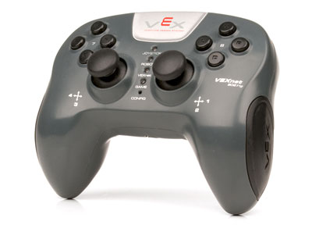
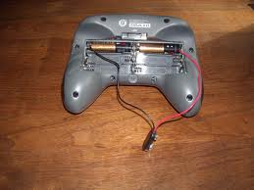
VEXnet Joystick
It requires six AAA batteries
If two joysticks are used, one must be the master and the other is slaved to it
Only the master gets the USB transmitter key

Slide 10
VEXnet Joystick
The joystick consists of two potentiometers mounted to a stick that vary as the stick is moved along its axis.
One potentiometer is mounted in the x axis or left – right direction and the other is mounted in the y axis or forward – backward direction.
As the potentiometer moves from one extreme to the other, the operator interface reads the voltage from 0 to 5 volts.
This voltage is broken into an 8 byte variable that ranges from 0 (0 volts) to 254 (5 volts).

Slide 11
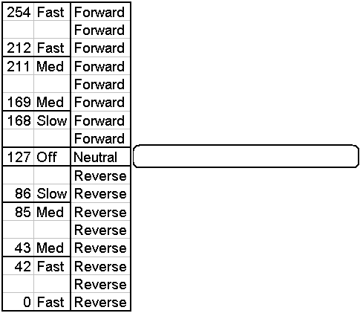
Joystick - continued
Full forward in the y axis will result in p1_y = 254.
When the joystick is in the center, it reads 127.
Full backward would read 0
Notes:
Picture looks like a joystick on its side to show relative readings as the stick is moved back and forth.
P1_y is the software variable assigned to joystick 1 y direction (forward and backward)

Slide 12
Calibrating the
Joystick
Calibrate a VEX Joystick
1. The Joystick must be “Linked” to the Cortex Microcontroller using the VEXnet Keys.
2. Hold the “6U” Back Switch depressed.
3. While the “6U” Back Switch is depressed, use a small Allen Wrench (1/16” or smaller) or similar small straight tool to
depress and hold the CONFIG Switch.
4. Hold both Switches depressed until you see the Joystick LED Flash RED and GREEN – you can now release both Switches.
a. There is a 10 second time limit to complete the following steps 5 and 6.
5. Now move both Joystick Pots to the maximum position desired in all 4 directions – Up, Back, Left, and Right.
a. If a movement is not detected in all 4 directions, a timeout will occur after about 10 seconds and the Cal Mode will be
discontinued and the VEXnet LED will briefly Flash Red.
b. The Joystick LED will continue to Flash RED and GREEN during the calibration process.
6. After movement is detected in all 4 directions, the Joystick LED will be ON and Solid GREEN.
a. To “Save” the Calibration, depress and release the “8U” Top Switch Button.
b. If the calibration is accepted and Saved, the Joystick LED will start Flashing Fast GREEN for a few seconds.
c. If the Calibration is not Saved, a timeout will occur after about 10 seconds and the Cal Mode will be discontinued and
the VEXnet LED will briefly Flash Red.
d. To cancel a calibration, depress and release the “7U” Top Switch Button. The Cal Mode will be discontinued and the VEXnet LED will briefly Flash Red.
e. If the Cal Mode is discontinued or saved, the Joystick LEDs will resume their normal function after the VEXnet LED briefly Flashes.
7. If Joystick Master Firmware is downloaded into the Joystick, the Joystick will need to be re-calibrated.

Slide 13
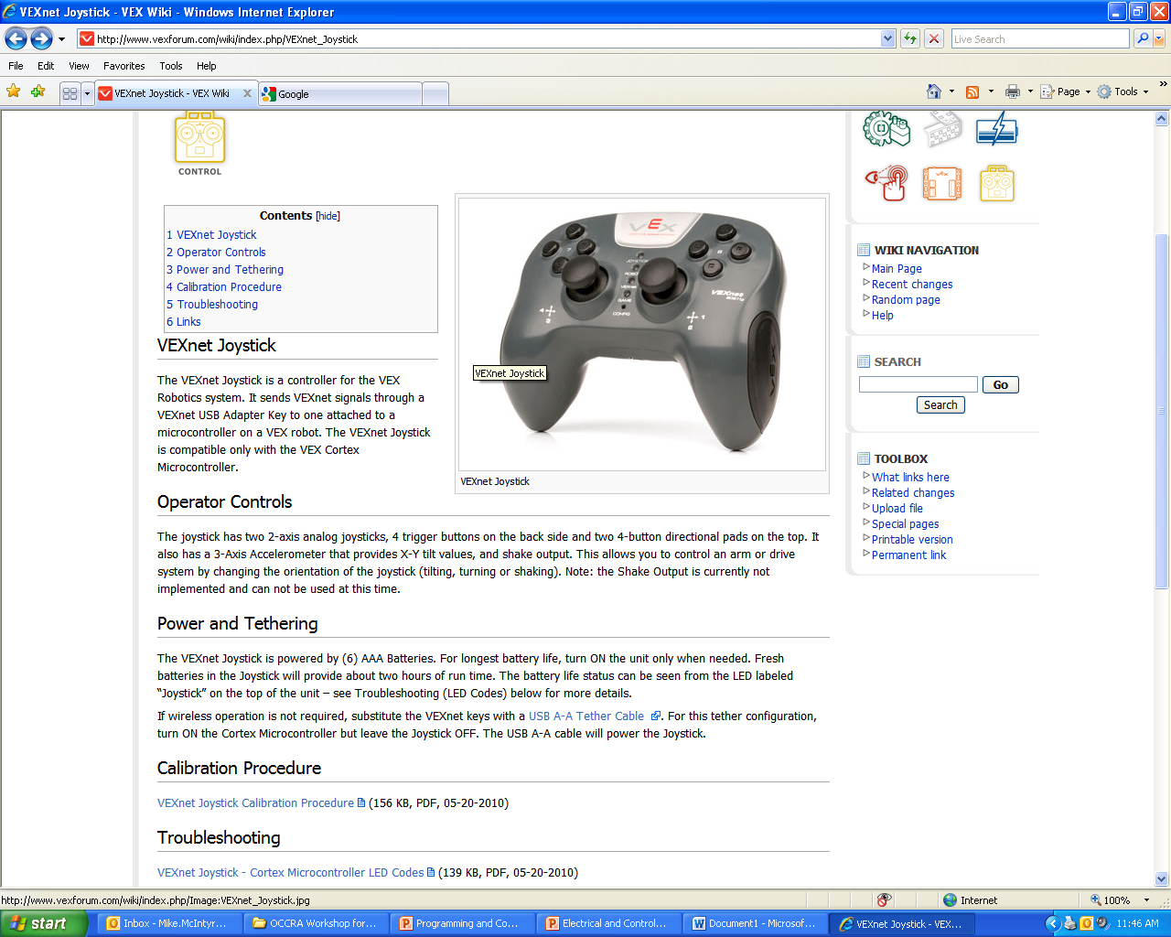
Use the Online Resources!

Slide 14
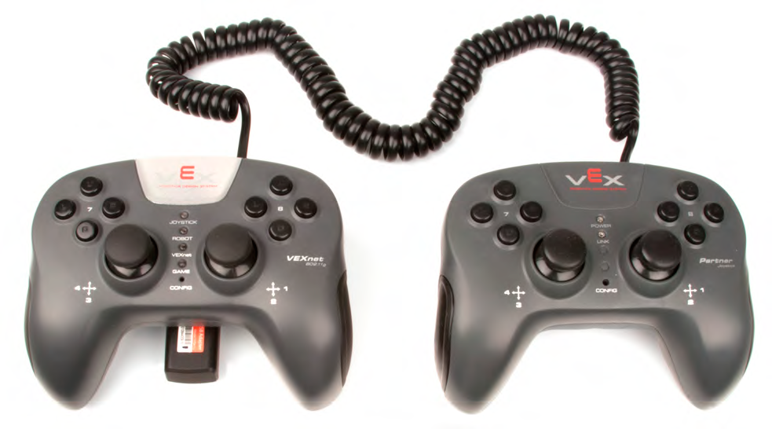
Using 2 Joysticks
Two Joystick Operation: If desired, a second Joystick can be added to allow two drivers to operate a single robot.
Simply connect a second VEXnet Joystick or a Partner Joystick to your main VEXnet Joystick using a coiled handset cable plugged into the Joysticks’ PARTNER Ports. Only the main Joystick should have a VEXnet Key installed.
For example, when using the Default Code for dual driver tank drive, you will need to install a jumper into Digital Port 11 in order to activate two-Joystick operation.

Slide 15
Using the default code
Default Operation: Refer to the attached figures for details and options of Joystick input to Motor response.
These motor directions will make a robot go forward when the joysticks are pushed up.
Note the Jumper variations for each section.
Please review and follow the tables in this document to ensure your robot behaves in the manner you wish.

Slide 16
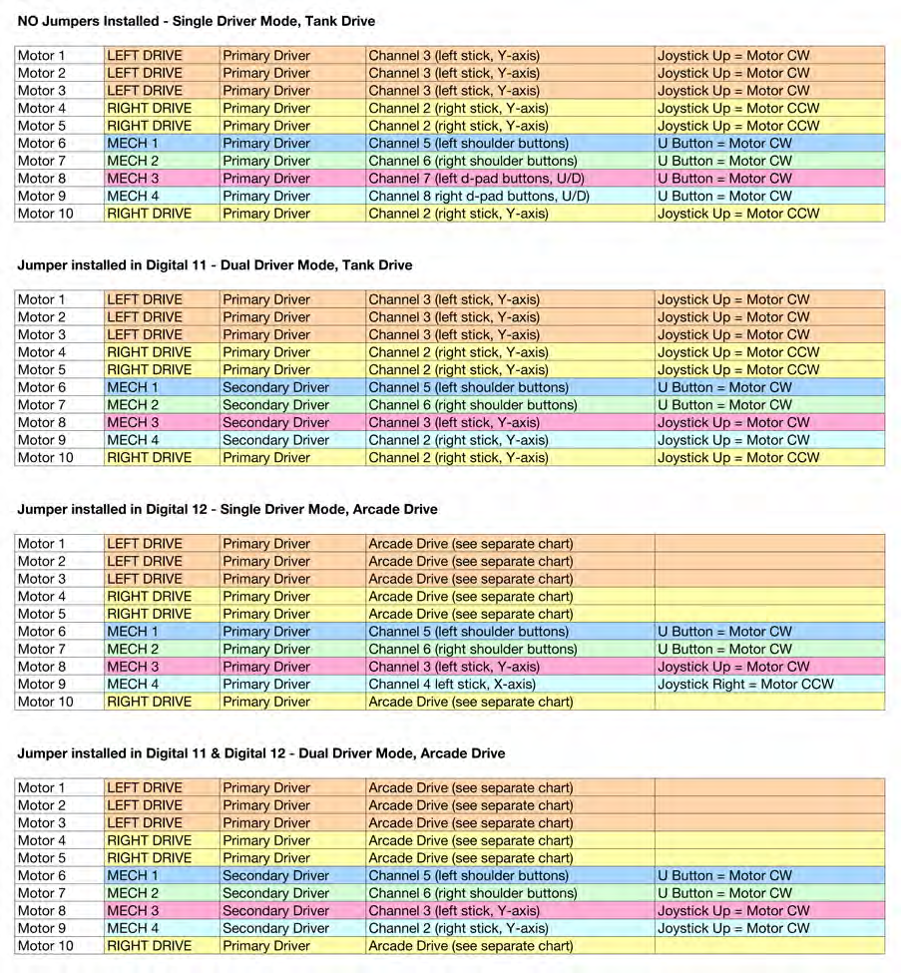
D
E
F
A
U
L
T
C
O
D
E

Slide 17
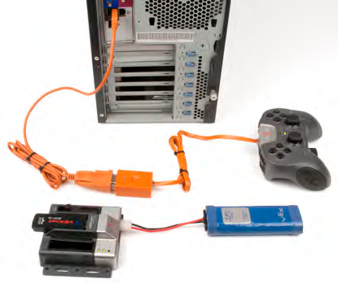
Wireless downloading of code

Slide 18
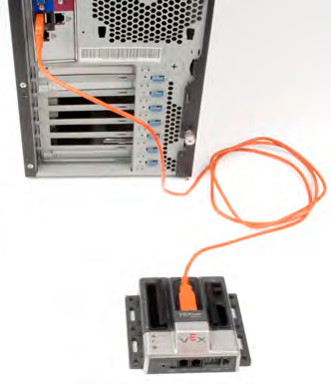
Tethered downloading of code

Slide 19

The VEXnet USB 2.0 Adapter Key
[DON’T USE THE OLD BLACK VEXNET 1.0 KEYS ANYMORE!]
Sends two-way wireless signals
Attach a 12V battery supply along with the VEXnet 2.0 key to the Cortex
Attach a VEXnet 2.0 key to the Master VEXnet joystick
Uses VEXnet 2.0 communication protocol over 2.4 GHz data radio

Slide 20
The VEXnet USB 2.0 Adapter Key
Rubber fins help retain key once installed
Functionally identical replacement for the black VEXnet 1.0 key
Caution: do not use a 1.0 key on one side and a VEXnet 2.0 Key on the other side of the link
Internal firmware on the VEXnet Key 2.0 is upgradeable - download the VEXnet Key 2.0 Firmware Upgrade Utility for more details.
[Note: The VEXnet Key 2.0 requires Firmware v4.0 or higher on both the Cortex and the Joystick; Visit www.vex.com/firmware to download.]

Slide 21
Speed Controllers
The input to the speed controller is a pwm signal that varies from software value of 0 to 254.
Battery and ground is supplied to two input terminals and the two output terminals can be wired to an electrical load like a drill motor.
At an input of 127, the two outputs which we will call m+ and m- are at 0 volt difference
As the pwm increases from 127 toward 254, the voltage varies from a positive difference of 0 to 12 volts.
As the pwm decreases from 127 towards 0, the voltage varies from a negative difference of 0 to 12 volts.
Notes:
The speed controller will allow the RC to be able to control the voltage to the motor. It controls the direction and speed of the motor by controlling the direction and voltage amount to the motor. Use the water valve explanation again.
Describe pwm as a on-off switch that is used to control the output because the RC is a digital device. Use example of accelerator pedal in a car. If we drove the car by pulsing the pedal all the way down and releasing in the right frequency and amount of time all the way down and released, we could control the vehicle speed. Increasing speed means the time of the pedal on the floor is longer than previously.
The software value or 0 to 255 tells the speed controller the amount of desired on time of the pedal.

Slide 22
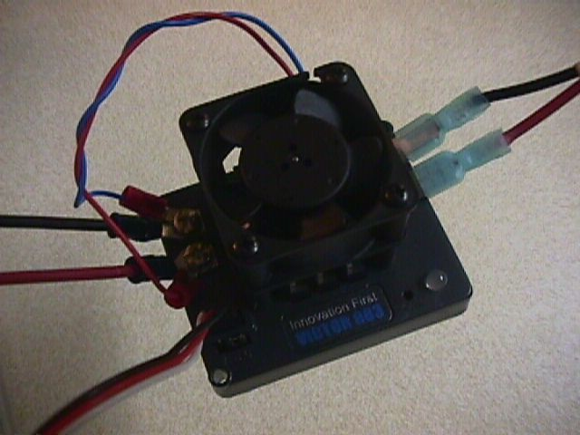
Victor Speed Controller
Be careful not to let debris fall onto it!
Make sure power leads are very secure
PWM cable must be oriented correctly

Slide 23
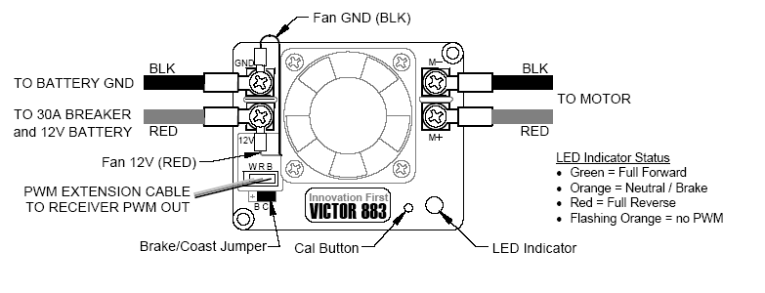
Still legal: Victor 883 or 884 speed controller
Notes:
Explain functions

Slide 24
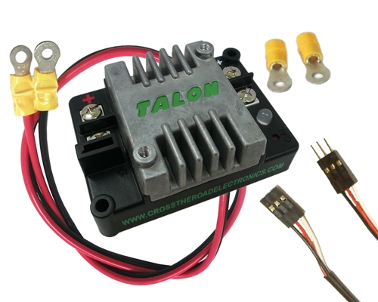
Also still Legal: Talon Speed Controller
Uses passive aluminum heat sink & greater efficiency, so no fan is needed! (but Mounting holes allow for an optional 40 mm)
Conformal coating provides resistance to metal chip shorts.
Tight, secure PWM connection
LED now blinks red/orange when a fault is detected. Faults are: low voltage on gate driver, over temperature and shorted FET.

Slide 25
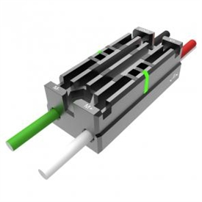
Our Newest Speed Controller: Victor SP
Less than half the size of older Victors previous models
Sealed enclosure prevents debris from getting inside
Full aluminum case, passive cooling fins, and sophisticated internal components make fans optional
Completely sealed enclosure prevents debris from getting anywhere it shouldn't be
Electrically insulated components allow for direct controller mounting to a robot frame with no fear of shorting
LED indicators blink proportionately to output speed for easier debugging
Illuminated "Brake / Coast Calibration" button enables one-touch setting changes and calibration
Robust embedded power & output cables will never shake loose during a match

Slide 26
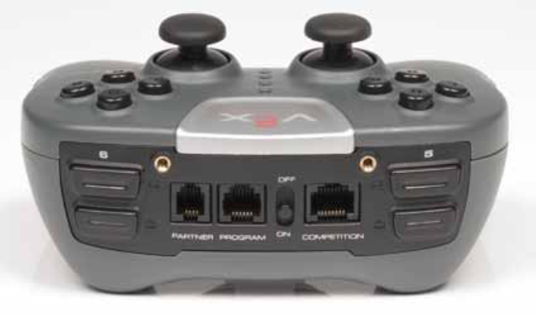
Joystick Switches
Located on the joysticks are twelve switches that are read by the computer as 0 or a 1. When the switch is closed, then the variable is read as a one.
These switch inputs are mapped to the relay outputs.
Check VEX Guide for default assignments

Slide 27
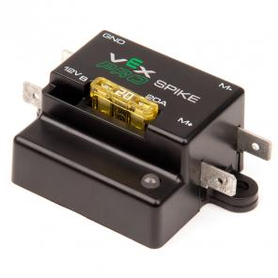
Spike Controller
The spike controller is a relay or electronic switch that will drive two outputs based on the inputs.
The reason for two input and two outputs are to enable the output to be driven positively or negatively to drive a small motor forward or reverse.
When the inputs to the relay are driven both as 0, then the outputs are both at 0 volts. One input is called Fwd and one is called Rev. One output is m+ the other is m-.
If the Fwd input is a 1 and the Rev input is a zero, then the m+ output will be 12volts and the m- output will be 0 volts.
The spike can be used to drive small motors, lights, solenoids on pneumatic valves, or any other 12 volt electrical load.
The concern is the limited current draw which is much lower then the speed controllers (only 20-A max.).

Slide 28
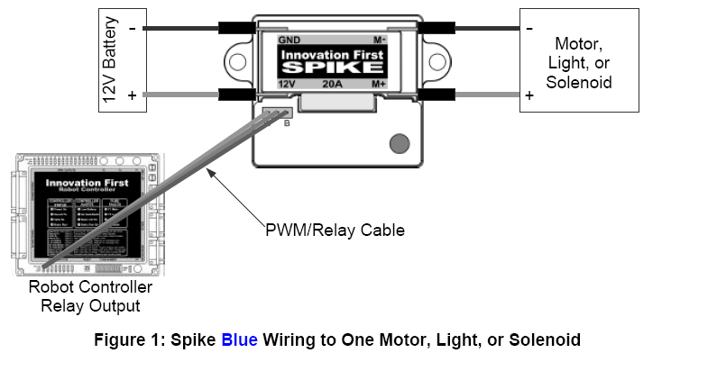
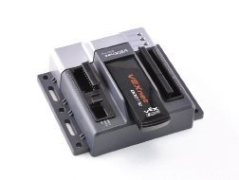
Spike Blue Controller
[Not Recommended Unless Tested for Current Needs]
Notes:
Explain functions

Slide 29
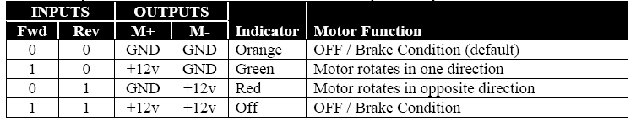
Spike Truth Table
The truth table for the input to output is as follows:
Notes:
Explain the outputs of the spike based on the inputs from the RC.

Slide 30
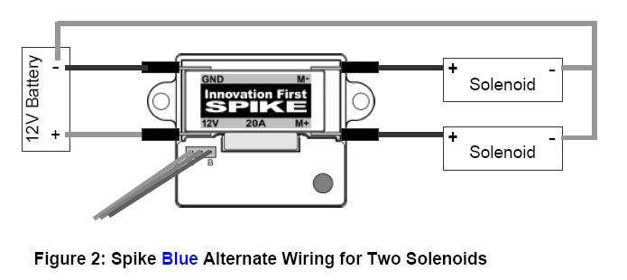
Spike alternative circuit
The spike can also be used to drive two different outputs in a on/off sequence.
An example would be two solenoid valves.
Notes:
Not to confuse people but to help better explain the functions of the spike.

Slide 31
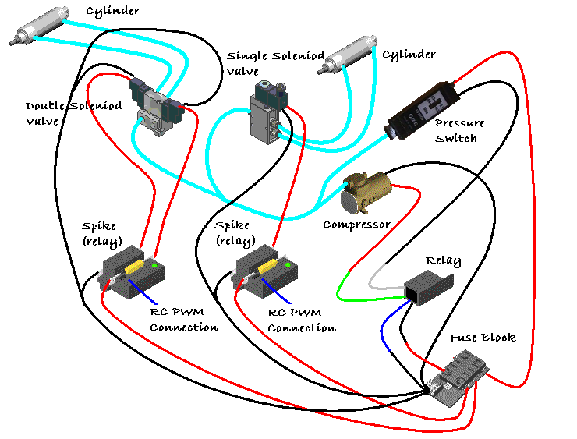
Pneumatic Controls Block Diagram
Notes:
A few slides to talk about the controls for the pneumatics

Slide 32
Pneumatic Controls
The air compressor is wired through a relay controlled by the pressure switch.
  When the pressure switch drops below the set switch point, the relay is energized turning on the air compressor.
  When the pressure exceeds the set switch point, the relay is de-energized turning off the air compressor.
Controlling the pneumatic cylinders is then accomplished through a single or double solenoid valve.
  “Single-acting” or single solenoid valve will extend the air cylinder while the solenoid is energized. When the solenoid is de-energized, the air cylinder will close.
  “Double-acting” or double solenoid valve will extend or open a air cylinder when one of the solenoids is activated and will close when the other solenoid is activated. After either solenoid is deactivated, the air cylinder will remain open or closed.
These solenoid valves are controlled via a spike.

Slide 33
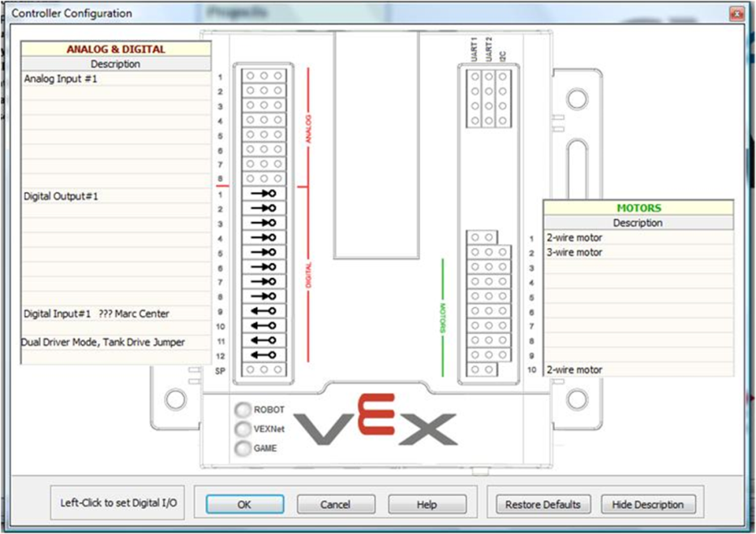
Necessary Modifications to
Hardware and Software

Slide 34
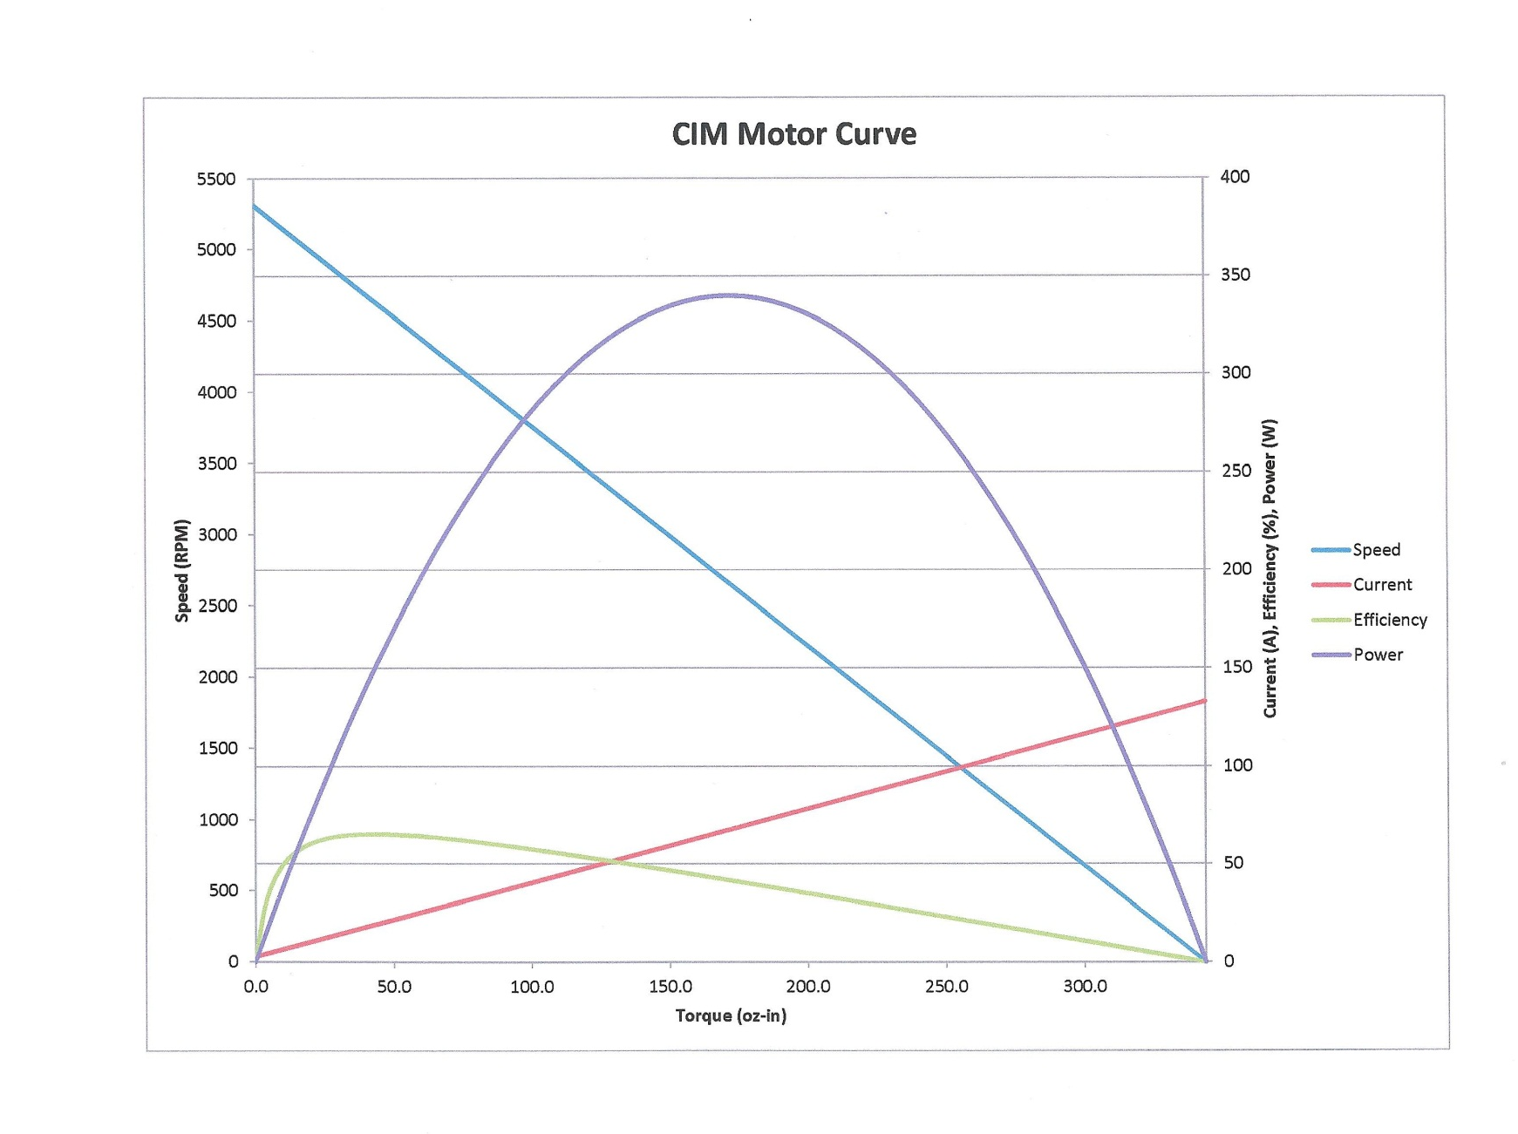
Motor Characteristics

Slide 35
Summary
There are other websites for resources.
The www.usfirst.org has many presentations on the subjects presented here.
The www.vexforum.com/wiki/index has all the documentation you need for VEX
The Oakland Schools official OCCRA
site is: http://occra.net
You can get interactive Q & A during the season at: http://www.chiefdelphi.com there is an OCCRA link on the home page

Slide 36
Any Questions???

